Slide 1

OODP101 Object Oriented Design and Programming
Final Exam Advice
T2-24
Kent Institute Australia Pty. Ltd.
ABN 49 003 577 302 CRICOS Code: 00161E RTO Code: 90458 TEQSA Provider Number: PRV12051
Version 2 – 18th December 2015

Slide 2
Final Exam details
Final exam will be face to face.
Final exam will be closed book.
Final exam will be of 2 hours + 10 minutes reading time.
Final exam will cover contents from Week 1 to Week 11 lectures.
You will be supplied with a question paper and answer sheet for the exam.
Please bring writing materials with you such as pens, markers etc.
Cell phones, smart watches and other portable electronic devices will not be permitted in exam.

Slide 3
Final Exam Marks and weightage
Weightage of your final exam is 50%
Final exam will be of 100 marks which will be scaled down to 50%

Slide 4
Final Exam Format
Section 1: Short Questions
There will be 6 short questions in Section 1, and you will have to answer 5 of them. Each question will be worth 8 marks
(5 x 8 mark = 40 marks)
Section 2: Long Questions
There will be 4 long answer questions in section 2, and you will have to answer any 3 of them. Each question will be comprising multiple parts, and you must solve all the parts for your selected questions. Each question will be worth 20 marks.
(3x 20 mark = 60 marks)

Slide 5
Final Exam Format
OODP101 Object Oriented Design and Programming– Final Exam Format
Question Layout
Section | Question Type | No. Of questions | Allocated Marks
1 | Short Answers | 5 | 40
2 | Case Study/Long Answers | 3 | 60

Slide 6
Important Topics
The exam would consist of questions from week 1 to week 11 lectures . Some of the important topics would be:
Variables and data types
Loops
Arrays
Classes and Objects
Inheritance
Polymorphism
ArrayList

Slide 7
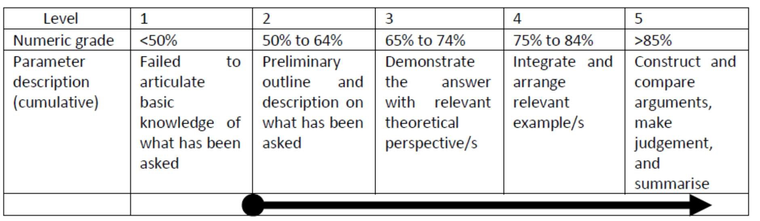
Final Exam Marking Rubric

Slide 8
Exam Instructions
Students should make every effort to attempt to answer all examination questions.
Questions may be answered in any order, but each Question answered requires it to be correctly numbered in the Workbook/Worksheet provided to complete the examination.
All Answers must be written in the Answer Booklet and be written clearly and legibly in blue or black ink.
At the end of the allocated time for the examination, the Examination Paper and Answer Booklet must be left on the desk you sat at for the examination or as instructed by the Examination Invigilator.
Students may request the Examination Invigilator for additional writing sheets if students require them.
If an Examination Invigilator has cause to suspect or witnesses' action by a student which is determined as academic misconduct, which may be cheating or possession of prohibited items, the student will be removed immediately from the examination room and the matter will be addressed in accordance with the Kent Academic Misconduct Policy & Procedures.

Slide 9
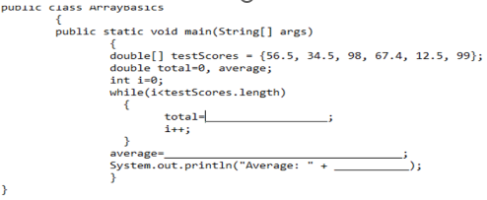
Section 1 – Short Answers – Sample Questions
Differentiate between compiler and interpreter.
Write any four file organization standards followed by programmers.
Fill in the blanks in the code snippet and explain what the completed code would do.

Slide 10
Section 2 – Long Answer Questions- Sample Questions
1. Write a java program to ask user to enter following inputs and store it in arrays
Monthly pay
Monthly expenses
And calculate and print following outputs
Yearly pay
Yearly expenses
Yearly savings
Month in which user earned maximum
Month in which user earned minimum
2. Explain Program development life cycle in detail and also explain tools used in planning the logic step with proper example.

Slide 11
Wishing you all the Good Luck for your exam!

Slide 12

kent.edu.au Kent Institute Australia Pty. Ltd. ABN 49 003 577 302 ● CRICOS Code: 00161E ● RTO Code: 90458 ● TEQSA Provider Number: PRV12051

